Slide 1
Capstone Project
Play Store App Review Analysis
By KULDEEP SINGH

Slide 2
Points Of Discussion
Introduction
Data Summary
Correlation
Top Categories
GAME Category
Distribution of the Ratings
Free and Paid comparison
Top 10 Expensive Apps
Highest Earning Apps
Content Rating
Genres
Positive - Negative Sentiment
Sentiment Polarity and Subjectivity
Conclusion

Slide 3
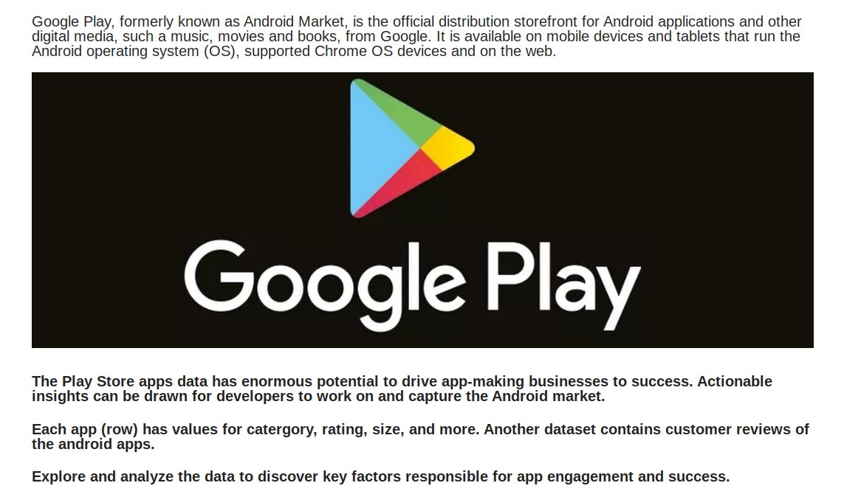
Introduction

Slide 4
Data Summary
We have two Datasets one is 'Play Store Data.csv' and Another is ‘User Reviews.csv’ Dataset.
shape : There are 10841 rows and 13 columns in 'Play Store Data.csv'.
columns: 1. App : Names of android apps.
2. Category : Category of apps.
3. Ratings : Average rating given by users.
4. Reviews : Number of Reviews.
5. Size : Size of app.
6. Installs : number of installs or downloads.
7. Type : Free or Paid.
8. Price : Price of app.
9. Content Rating : Suitable age group.
10. Genres : genres of app.
11. Last Updated : last updated date.
12. Current Ver : current version available.
13. Android Ver : Supported android versions.

Slide 5
Data inside 'user review.csv'
Shape : There are 64295 rows and 5 columns.
columns : 1. App : Name of app.
2. Translated_Review : Reviews given by users.
3. Sentiment : Positive, negative or Neutral opinion.
4. Sentiment_Polarity : Polarity is float which lies in the range of [-1,1] where 1 means positive statement and -1 means a negative statement.
5. Sentiment_Subjectivity : Subjectivity quantifies the amount of personal opinion and factual information contained in the text. The higher subjectivity means that the text contains personal opinion rather than factual information. Subjectivity lies between [0,1]

Slide 6
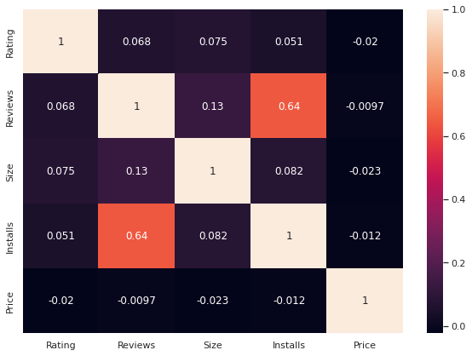
Correlation
----observations----
Rating Reviews Size and Installs all has positive correlation between them.
Only price has negative correlation with every other variables

Slide 7
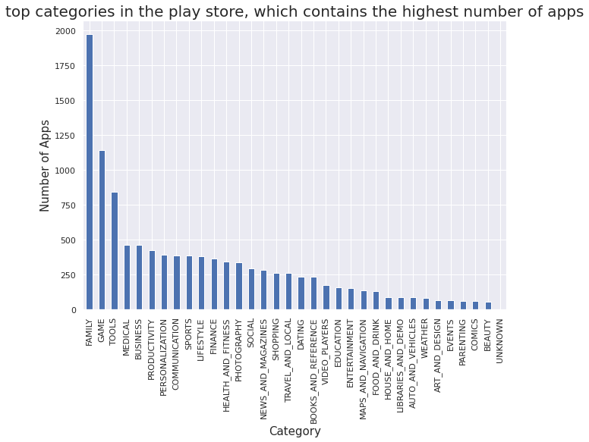
Top Categories
what are the top categories in the play store which contains the highest number of apps?
----observations----
There are more than 30 categories.
Family, game and tools category has most number of apps in playstore.
Comics and Beauty has least number of apps in playstore.

Slide 8
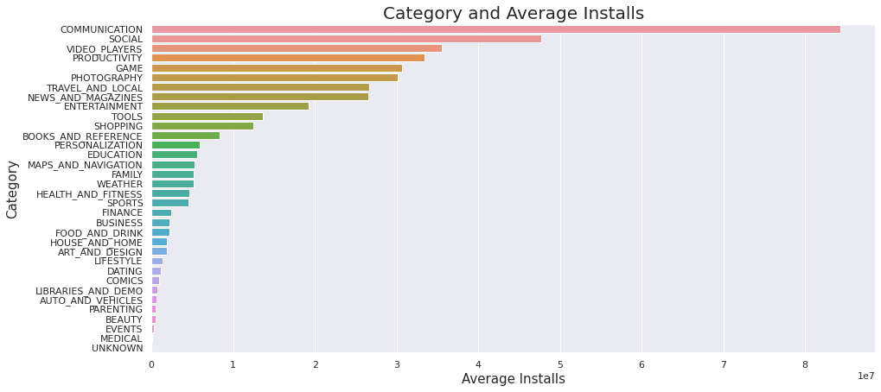
----observations----
Most downloaded category based on average installs is 'Communication'.
Least are Beauty, Events and Medical.

Slide 9
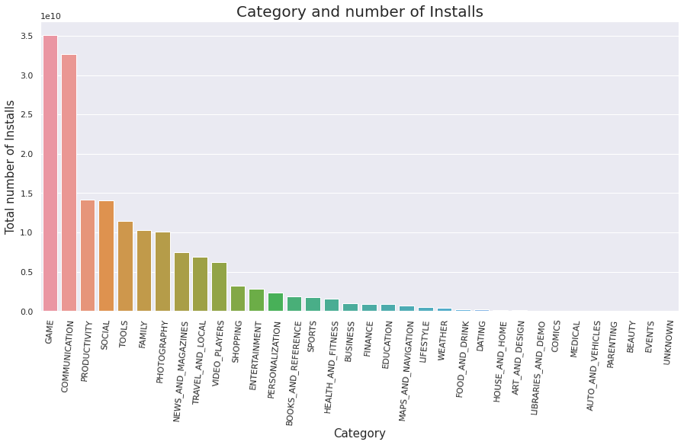
Most Installed Category
----observations----
Game and Communication category has highest number of Installs.
Beauty and Events has least.

Slide 10
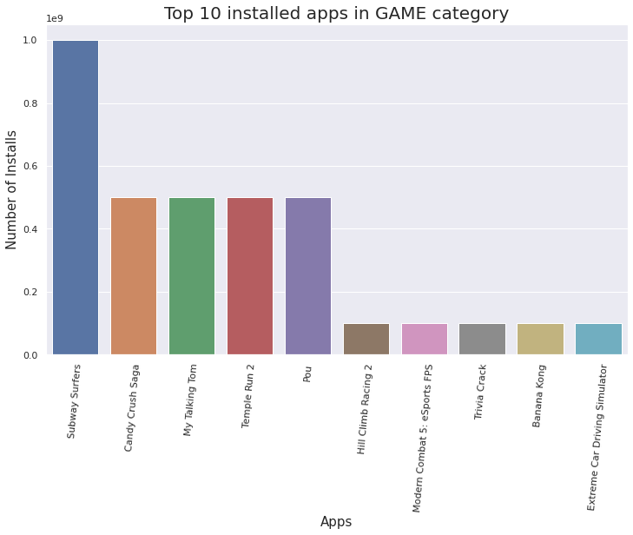
GAME Category
----observation----
Subway Surfers game has highest installs.
Candy Crush, Talking Tom, Temple Run 2 and Pou has almost same number of installs.

Slide 11
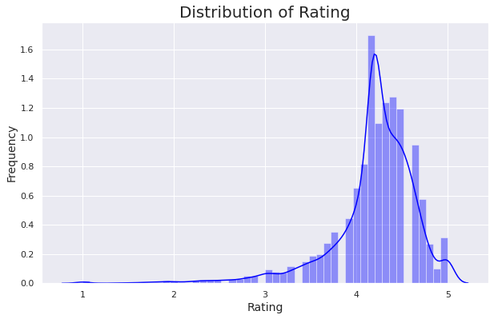
Let’s have a look at the distribution of the ratings of the data frame.
----observations----
Most of the apps in the google play store are rated between 3.5 to 4.8.

Slide 12
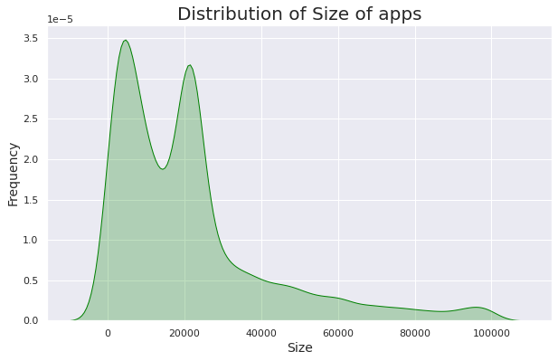
----observation----
The size of most apps in playstore are between less than 1 mb to 30 mb.

Slide 13
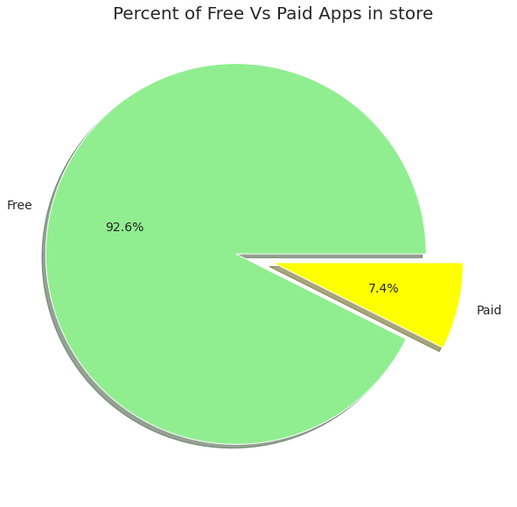
Free and Paid comparison
what portion of the apps in the play store are paid and free.
----observations----
92.6% of apps in the google play store are Free.
7.4% are Paid.

Slide 14
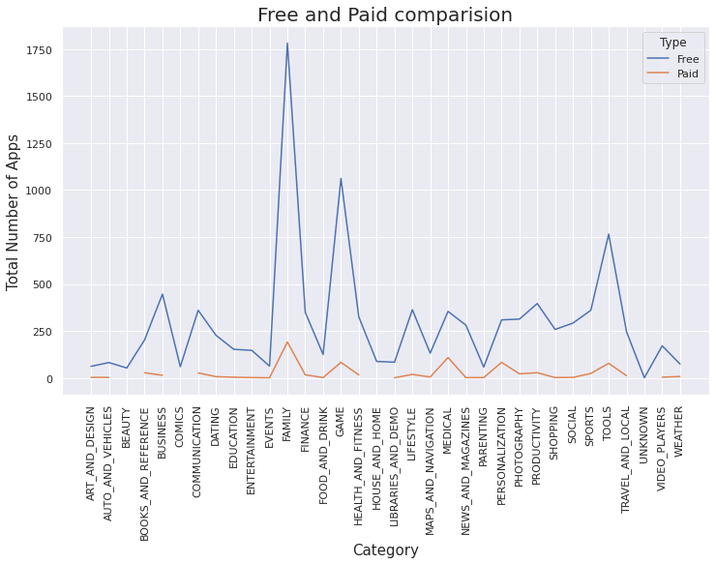
Category wise number of free and paid apps comparison.
There is no category having more paid apps than free.

Slide 15
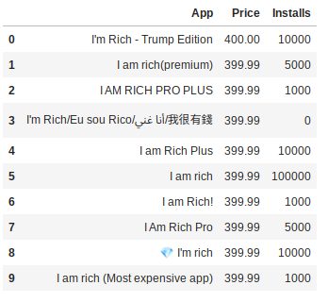
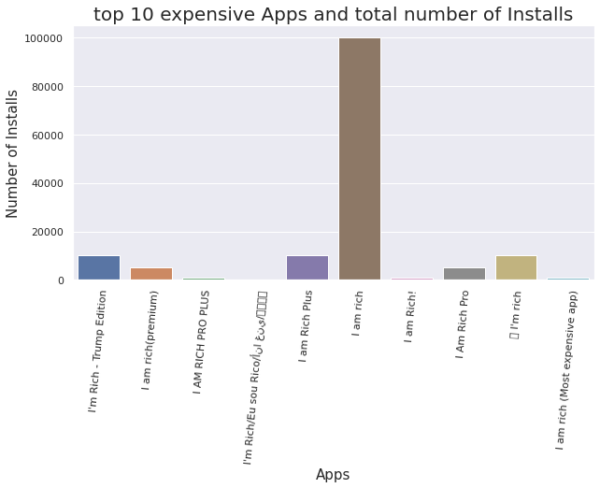
Top 10 Expensive Apps
----observations----
The most expensive app is "I'm Rich - Trump Edition".
'I am rich' app has most installs among all 10.

Slide 16
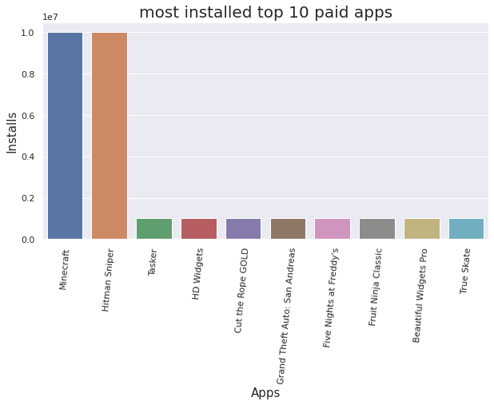
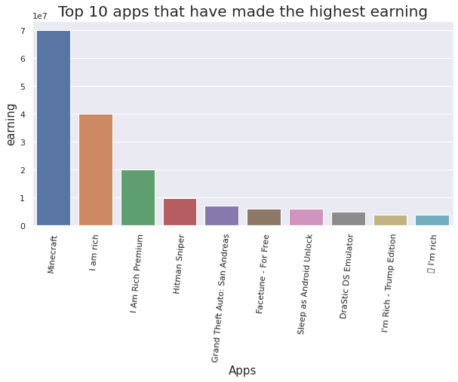
Top 10 apps that have made the highest earning
----observations----
Minecraft has made the highest earning.
Minecraft and Hitman Sniper are most downloaded apps.

Slide 17
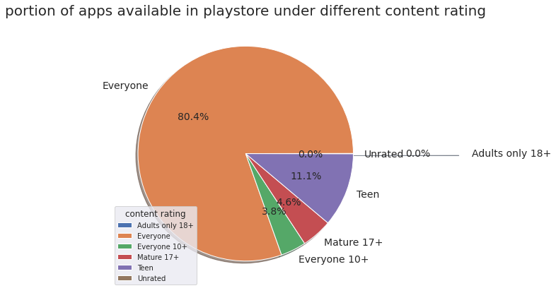
Content Rating
what portion of apps available in playstore under different content rating.
----observations----
80%(approx) of apps in the google play store are for Everyone.
11.1% for Teen
4.6% for Mature
3.8% for Everyone 10+

Slide 18
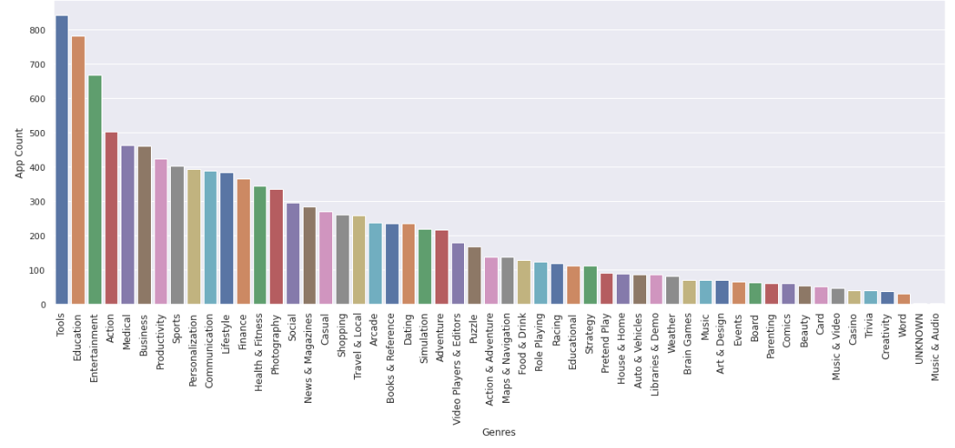
Genres
Total number of apps available in playstore under different genres.
----observations----
Top 3 genres having highest number of apps are 'Tools', 'Education' and 'Entertainment'.
There are more 50 different genres available in playstore.

Slide 19
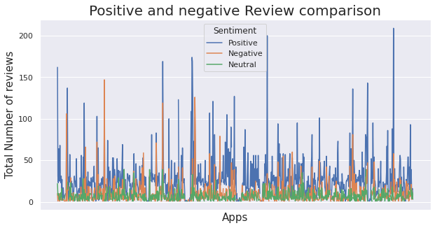
Positive - Negative Sentiment
----observations----
Most of the apps has more positive sentiments.
Overall Positive Sentiments are more in comparison to Negative.

Slide 20
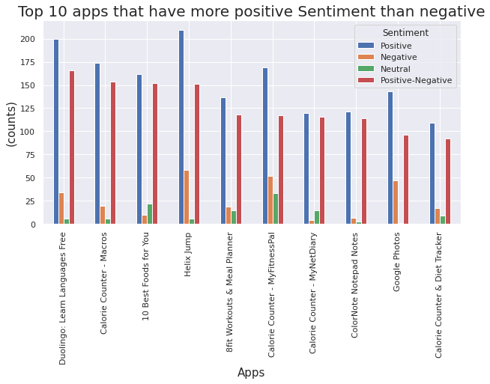
----observations-----
Duolingo: Learn Languages Free has more Positive-Negative counts.
Calorie Counter - Macros, 10 Best Foods for You, and Helix Jump are on 2nd, 3rd, and 4th place in race of positive-Negative counts respectively.

Slide 21
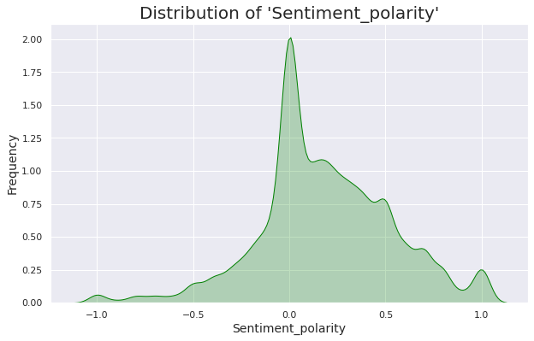
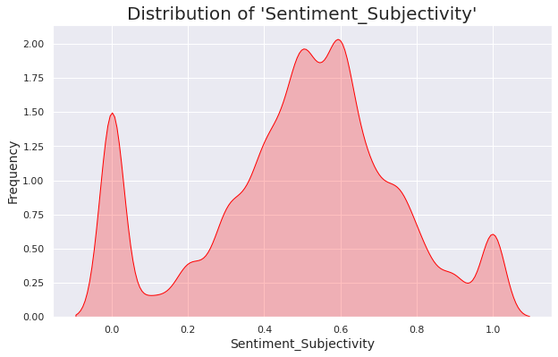
Sentiment Polarity and Subjectivity
----observations----
Most of the review's Sentiment_polarity score is between -0.3 and 0.5
More positive score than negative.
Most of the review's Sentiment_Subjectivity score is between 0.3 to 0.8
There are more sentiment subjective reviews as compared to neutral.

Slide 22
Conclusion
After Analyzing the datasets we have got answers to some of the serious & interesting questions which will help any business planning to launch their app, also it will help existing business to improve their apps.
Instances & Observations we have discovered after Analyzing the datasets:
There are more than 30 categories in the playstore.
Family category has most number of apps in playstore.
Comics and Beauty has least number of apps in playstore.
Most downloaded category based on average installs is 'Communication'.
Game and Communication category has highest number of Installs.
Subway Surfers is most downloaded Game in the Playstore.
Most of the apps in the google play store are rated between 3.5 to 4.8.
92.6% of apps in the google play store are free and only 7.4% are Paid.

Slide 23
v
The most expensive app is "I'm Rich - Trump Edition" in the Playstore.
Minecraft has made the highest earning.
Also Minecraft is the most downloaded app among all paid apps.
Most of the apps has more positive sentiments.
Overall Positive Sentiments are more in comparison to Negative.
Duolingo: Learn Languages Free has more Positive-Negative Sentiment Reviews.
Most of the review's Sentiment_polarity score is between -0.3 and 0.5
More positive Sentiment_polarity score than negative.
Most of the review's Sentiment_Subjectivity score is between 0.3 to 0.8
There are more sentiment subjective reviews as compared to neutral.

Slide 24
Thank You

